Slide 1
Code Crumbs
Web Pro Group Project 1
Jash Thakkar, Harshita Karmunji, Julius Randle

Slide 2
Intro - The why?
The problem that we saw is that getting a clean way to get recipes that are easy, accessible, and comprehensive to follow along is very hard. When doing market research we found many sights that were littered with poor styling which made it hard to follow along.
This is significant because today in the USA we face a epidemic of poor diets, where people continue to eat unhealthy. There are many reasons to why people eat unhealthy but one of the primaries reasons is simply how hard it is to get ideas for meals to cook at home.
The goal of this project is to show how simple and easy it can be to cook at home to help move us away from the epidemic of poor diets, and into a new world of delicious fresh cooked meals.

Slide 3
Let’s See the Site

Slide 4
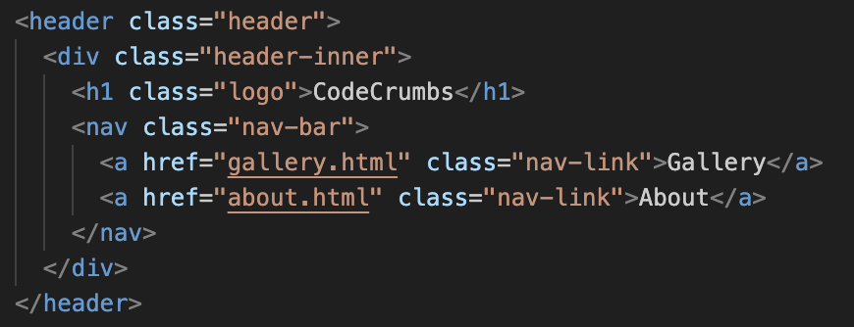
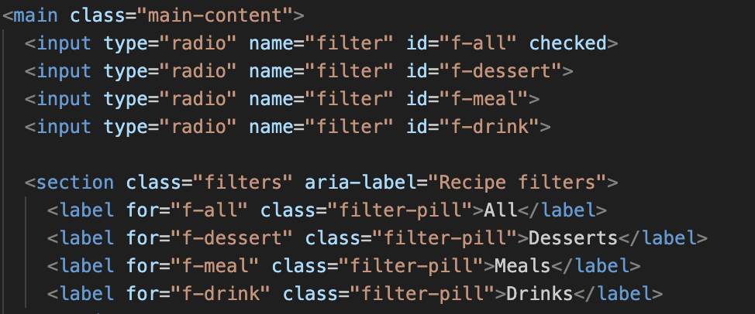
Code
Highlights
Snippet 1: Nav bar
Snippet 2: Recipe Filter

Slide 5
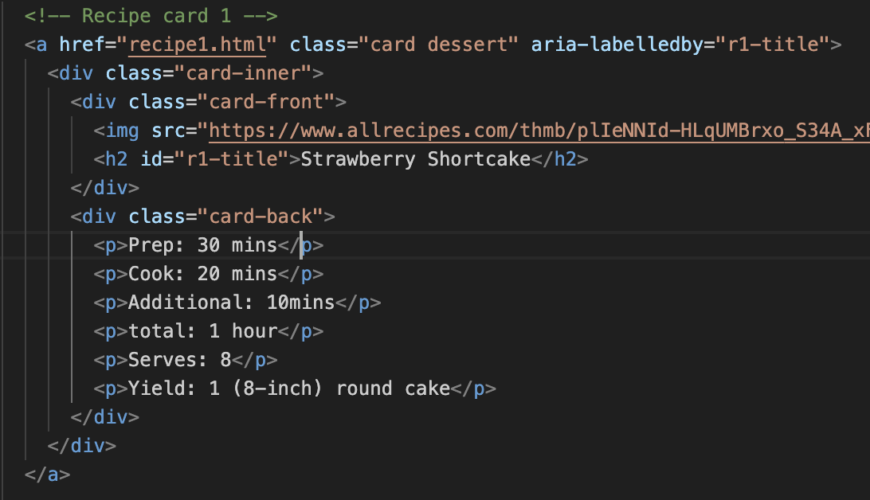
Code Highlight (cont)
Recipe Cards
Modle:

Slide 6
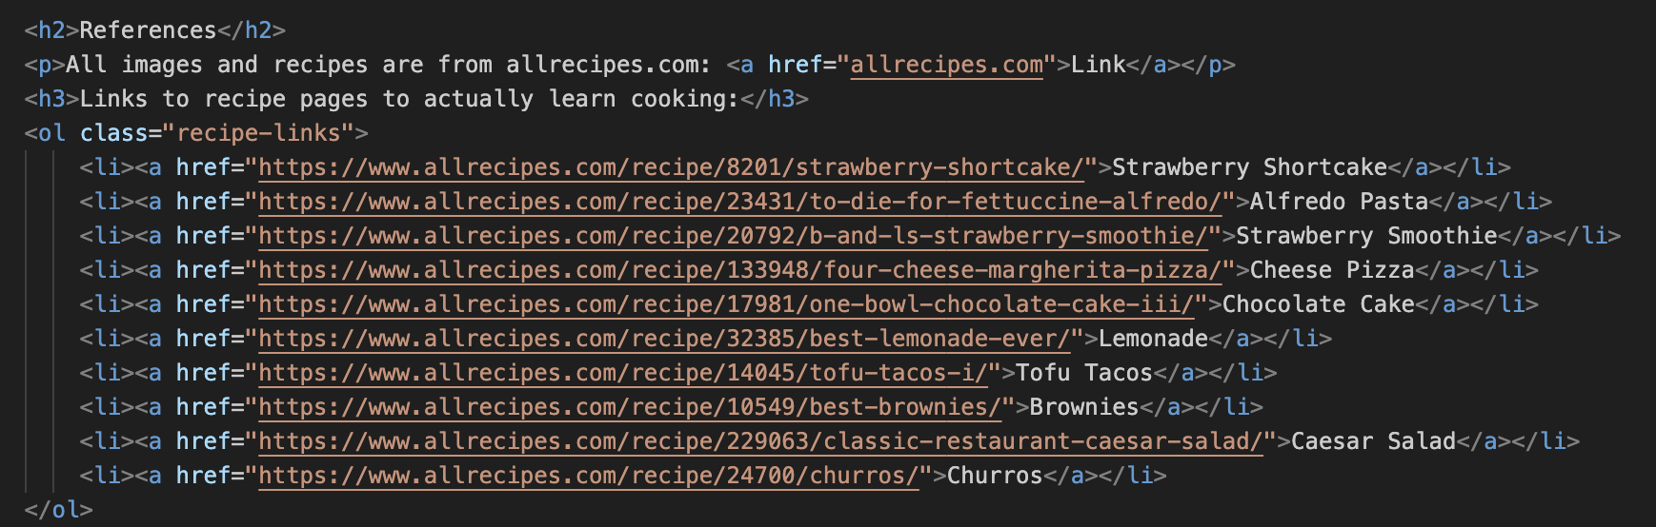
Code Highlights (cont)
References:

Slide 7
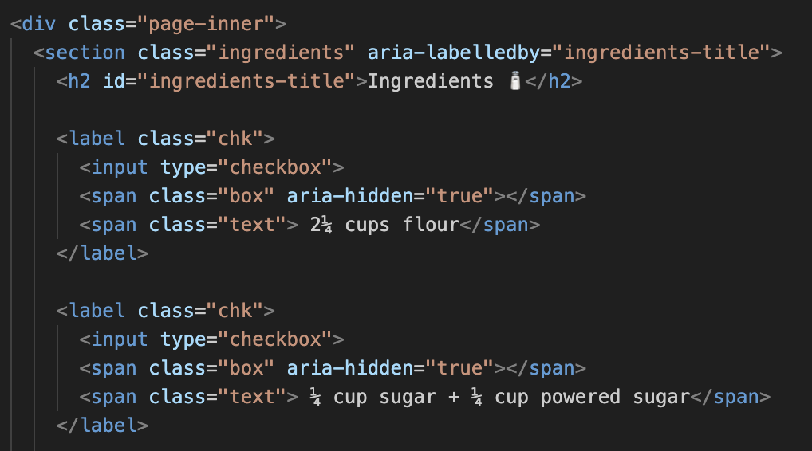
Code Highlights (cont)
Ingredients Checkbox

Slide 8
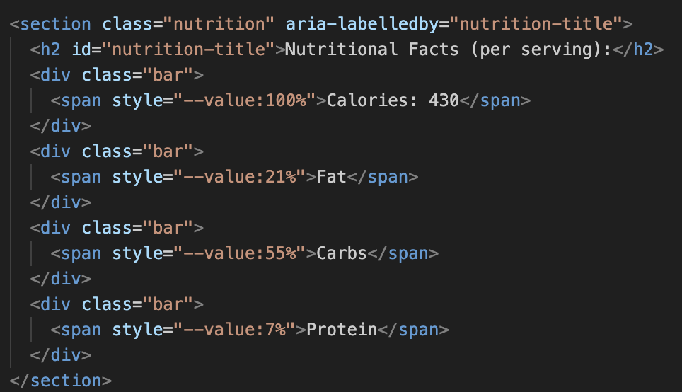
Code Highlight (cont)
Nutrition info:

Slide 9
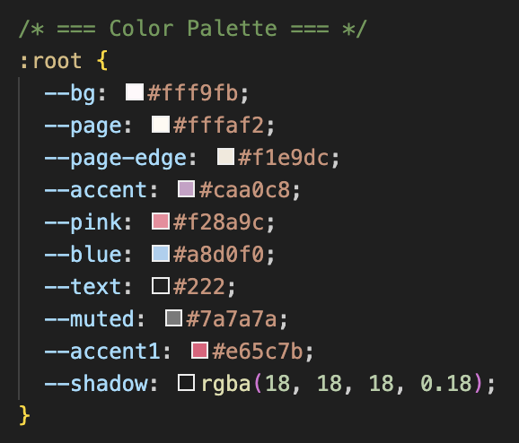
Coding Highlight (Cont)
Color Pallet:

Slide 10
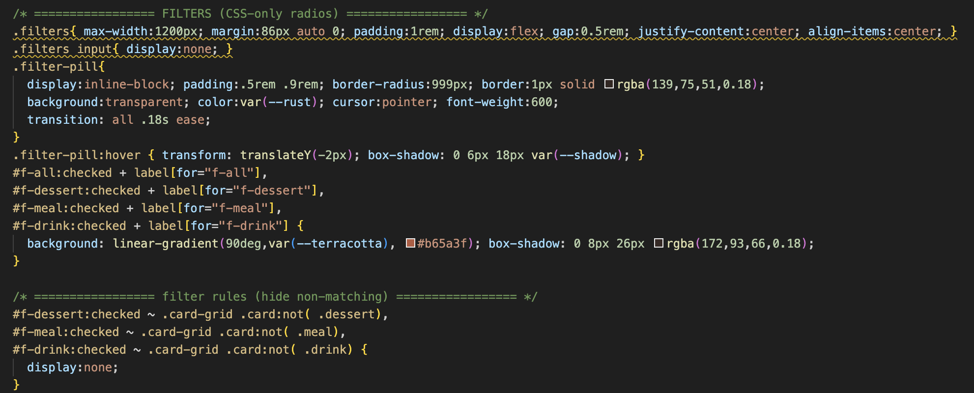
Coding Highlight (Cont)
our office

Slide 11
Conclusions / Takeaways / Improvements
Takeaway:
This sight is made to be a reminder to us all that we should strive for a healthier lifestyle and the first step can be cooking at home
Achievements:
We here have made a small website with easy to read, navigate, and understand recipes for all people who want to cook at home.
Impact:
We hope to make more people make the conscious decision of ditching fast-food, and choosing to cook at home.
API:
Moving forward we would love to find or build an API that has recipes that have ingredients, steps to cook, and nutritional facts.
Healthier OPT:
We would love to add a “B” side to the site where it is all the same recipes we love but in a more healthier and low fat, high protein way.
User Based
We want to have users be able give the site recipes that they love and live by so the rest of the world can try them too.

